Slide 1
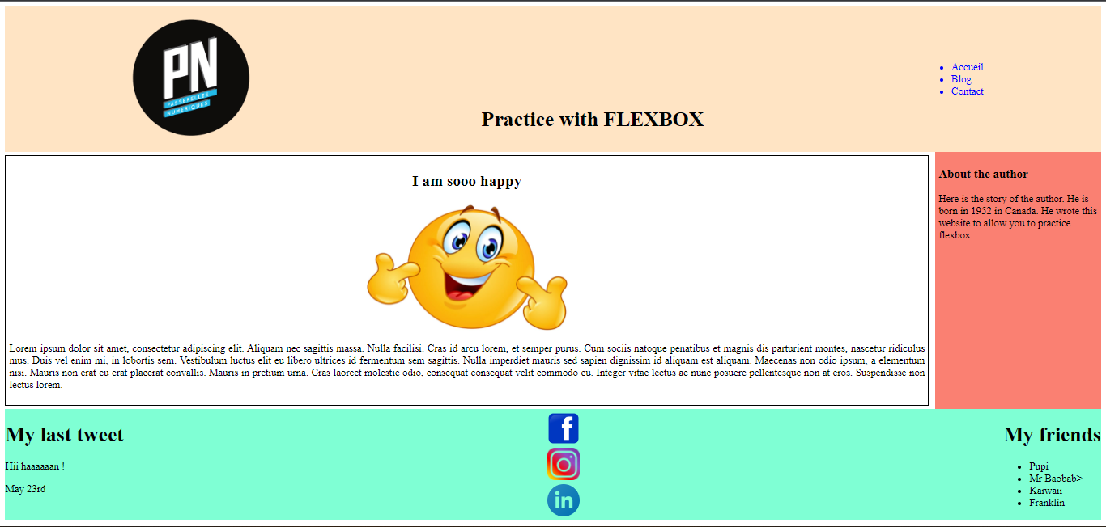

Slide 2
To Do :
Complete css code to diplay as the slide 1
Don’t change html code

Slide 3
Page structure :
LOGO
HEADER
NAVIGATION
ARTICLE
ASIDE
FOOTER

